Slide 1
F.L.U.F.F.I.E
Functional, Logical & Ultimate Food Forecasting
with Intelligence and Efficiency
Team Name: AiWizdom
Category 1: AI Powered Automation Solutions

Slide 2

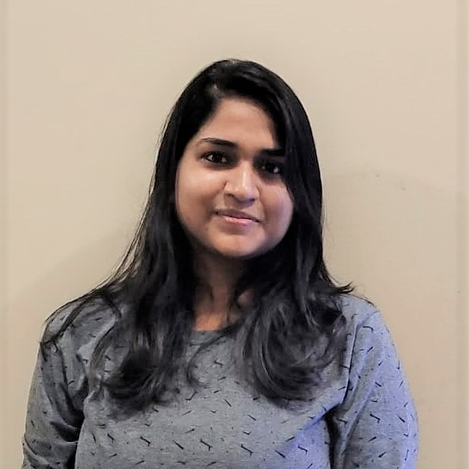


Team Slide
Pradeep Murugesan
Madhurima Sundaram
Noodhana Rangarajan
Yadukrishnan SunilKumar
RPA Lead
pradeepm@vuram.com
RPA Developer
madhurimas@vuram.com
RPA Developer
noodhanar@vuram.com
RPA Developer
yadukrisnans@vuram.com
Notes:
Please replace photograph with your team member by right click on image > change picture
Please add role and company name and add your email ID.
Feel free to remove extra picture and details if team size is smaller

Slide 3
Problem Statement & Proposed Solution
Problem
Solution
Hotels generate a significant amount of food waste, which has a negative impact on the environment and the restaurant's bottom line.
Despite increasing concerns about hunger, environmental sustainability, and resource conservation, a substantial amount of food is wasted at various stages of the food supply chain, from production and processing to distribution and consumption.
By implementing F.L.U.F.F.I.E, Hotels can reduce waste, save money, and improve their sustainability efforts through predicting the amount of food required to be prepared based on the day, weather, events, holidays, reservations made and other factors.
In case of any food remaining, it can still be diverted from landfills to donation programs.
Notes:
Problem: Please briefly mention what is the problem you are trying to solve / what is problem statement Solution: What approach you took to solve the problem/ what is the solution / your solution to the problem

Slide 4
Benefits & Technologies Used
Details
Benefits
End-User | Restaurants and Group homes
User Department | Food Service Department
Industries | Hospitality and Service
UiPath Products Used | UiPath AI Center, UiPath Apps, Document Understanding, Data service, Studio web, Task Capture, Action Center
Other – Integrations / APIs / Technologies Used | Python, Open AI Integration(Chat GPT), Database, API, gmail,Google form
This system reduces the cost spent on the raw materials, efforts, time, resources right from transportation to producing and serving the food and improves operational efficiency
Donating excess food to local food banks or charities instead of throwing it away and support the local communities.
We can alleviate hunger, conserve resources, protect the environment, and promote a more equitable and sustainable food system.
Notes:
Details: Its always good to share details like who is the end-user of your solution, which department/industry will benefit and what technologies have been used.
Benefits: Please include key features / value proposition of your solution

Slide 5
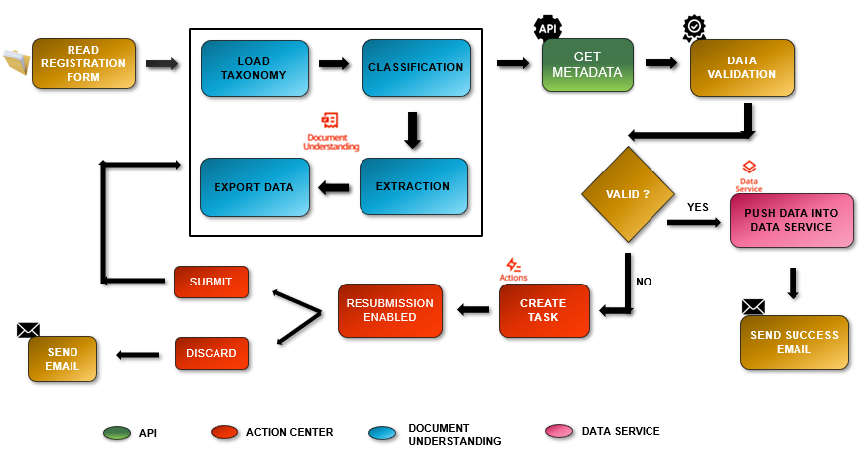
Solution Architecture - PrePhase
Notes:
You can remove the slide if you are not showing Solution Architecture

Slide 6
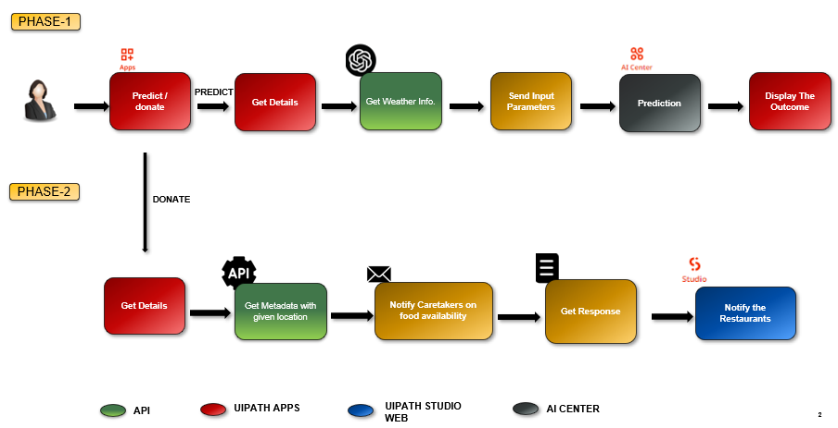
Solution Architecture - Phase 1 & Phase 2

Slide 7
THANK YOU

